Slide 1



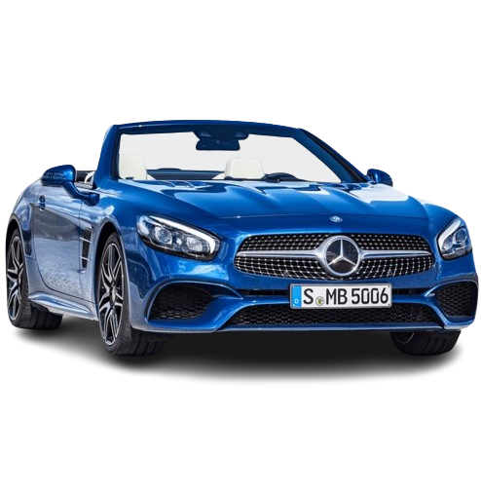
FSD PROJECT
Title
Introduction
Functionalities
Problem Solved
Future Scope
Car Sales
AUTOMOBILE WEBSITE
By Ekal Sorathiya
Computer Engineering
A6
22002170110028

Slide 2
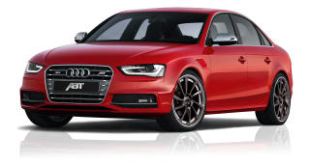
Title
Introduction
Functionalities
Problem Solved
Future Scope
With Python interface –Tkinter (GUI)
Automobile Website With All Luxurious Brand

Slide 3
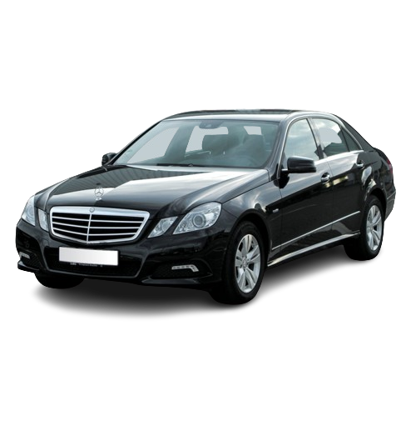
Title
Introduction
Functionalities
Problem Solved
Future Scope
Sign Up
Login
All Luxurious Brand
Cars Specifications
Book A Test Drive

Slide 4

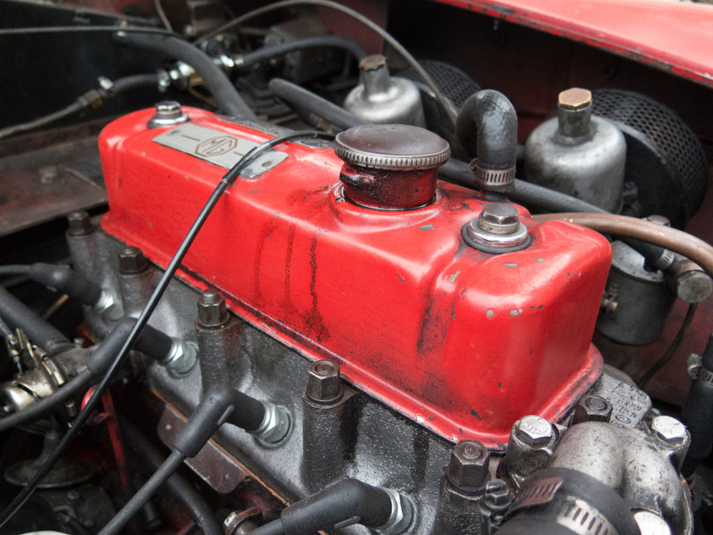
Problem Solved
Future Scope
Title
Future Scope
Title
Introduction
Introduction
Functionalities
Functionalities
Surfing Same Websites
Virtual Showrooms
Price Comparison
Rumoring Around For Test Drives

Slide 5

Problem Solved
Future Scope
Title
Future Scope
Title
Introduction
Introduction
Functionalities
Functionalities
Decoding With Bugs
Hassle Free
Integrating With Django
Showing Data Of More Cars Not Just 30-40 Cars Dynamically
Making Interface For Comparison Between Two Or More Cars

Slide 6
ANY QUESTION ?

Slide 7
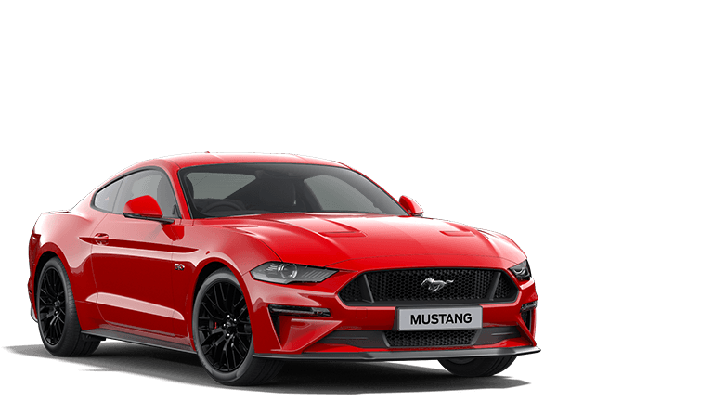
Thank You!

